Slide 1

Project Management 101
Review Session

Slide 2

Schedule
Agenda | Time | Notes
Introduction | 930am | Session overview
PM101 Review | 940am | Key Concepts and Documents
Your Project Proposal | 1010am | Go over components of a Project Proposal
Sample Project Submission | 1030am | "Discovery Day" sample submission
Next Steps + Q&A | 1130am
Conclusion | 12pm

Slide 3
PM101 – Review Session
Project Initiation (Starting a Project)
Project Planning (Getting Organized)
Project Execution (Performing the Work)
Project Monitoring (Monitoring Progress)
Project Closing (Closing Out)
Notes:
Feedback from survey: traditional courses very dry, decided to teach a course more immersive

Slide 4
PM101 – Review Session
Project Initiation (Starting a Project)
  Project Definition (Temporary, Unique, Coordinated Undertaking)
  Business Need
  Project Justification
  Product Description/Deliverables
  Stakeholders
  Constraints
  Assumptions
  Signoff
  Project Charter Walkthrough
Notes:
Stakeholders: People who will affect or be affected by the outcome of a project
Constraints: Factors that might restrict a team’s options and typically are imposed externally on the project or team. Examples: Budgets and Deadlines
Assumptions: Factors that for planning purposes might be considered to be true, real or certain
Formal endorsement of the Project by Management
Establishes the identity of the Project Manager & Team

Slide 5
PM101 – Review Session
Project Planning (Getting Organized)
  Scope (What has to be done)
  Time (When it has to be done by)
  Cost (How much Money and Resources with which to do the work)
  Quality (How do we know we succeeded?)
  Risk (What could go wrong?)
  Human Resources (How do we build the team?)
  Communications (How do people know how/when/what to do?)
  Procurement (Who could we pay to do the work?)
Notes:
Feedback from survey: traditional courses very dry, decided to teach a course more immersive

Slide 6
PM101 – Review Session
Project Scope
  The Triple Constraint (Time/Cost/Scope)
  Scope Statement (Extension of the Project Charter)
      Project Scope Description
      Acceptance Criteria: What must be completed in order for the project to be considered a success
      Deliverables
      Exclusions
      Constraints & Assumptions
  Project Scope Statement Walkthrough
Notes:
Feedback from survey: traditional courses very dry, decided to teach a course more immersive

Slide 7
PM101 – Review Session
Project Scope
  WBS (Work Breakdown Structure)
    Product Orientation: What do we need to build (not how)
    All of the work that has to be performed on the project
    Hierarchical in nature
    Decomposition: Breaking down project deliverables into smaller, more manageable components
    Work Packages (4-80 hours ~ depends?)
  Project WBS Walkthrough
Notes:
Feedback from survey: traditional courses very dry, decided to teach a course more immersive

Slide 8

PM101 – Review Session
Project Time
  Activity Definition
    Target a WBS component
    What tasks must be performed in order to complete the WBS component
    Try to involve experts
  Activity Duration Estimates
    PERT Estimates (Pessimistic/Most Likely/Optimistic)
    Benchmarking
  Milestones (Zero duration)

Slide 9
Getting Organized
Project Time Management
  Activity Sequencing
    Correct sequence of performing activities now that they have been defined
    Dependencies (Mandatory/Discretionary)
  Network Diagrams
    Depicts activities the relationship and dependencies between the activities
  Optimization
    Crashing
    Fast Tracking

Slide 10
PM101 – Review Session
Project Costs
  Estimates
    Top Down (Budgetary Estimates)
    Bottom Up (Detailed)

Slide 11
Getting Organized
Project Human Resources
  Building the Team
    Human Resource Plan
    Acquire Project Team
    Develop Project Team
    Manage Project Team
Notes:
Human Resource Plan: Identifying; documenting and assigning project roles and responsibilities and reporting relationships, as well as creating a staffing management plan.
Acquire Project Team: Getting the right people to do the job. Actually going out and tracking these people and bringing them on board the project team..
Develop Project Team: Develop our individual and group skills in order to enhance our overall team performance.
Manage Project Team: Tracking team member performance, providing feedback and resolving issues and conflicts that may arise during the course of a project.

Slide 12
PM101 – Review Session
Project Execution (Performing the Work)
  The Kickoff Meeting
  Work Authorization System
  Resource Assignment Matrix
  Managing Conflict - Team Building
      Interdependence of Team Members
      Common Consensus
      Group Work Commitment
      Accountable as a Functional Unit
      Acknowledgement of Conflict
Notes:
Feedback from survey: traditional courses very dry, decided to teach a course more immersive

Slide 13
PM101 – Review Session
Project Monitoring and Controlling (Monitoring Progress)
Status Meetings
Sample RAG Report (Red Amber Green)
Notes:
Lasts less than an hour
Goes through ongoing project tasks
Methodical and organized format.
Agenda:
Summary of Status
Open Action Items
Open Risks and Issues
Closing the meeting

Slide 14
PM101 – Review Session
Project Monitoring and Controlling (Monitoring Progress)
  Change Management (Change Control Boards)
Project Closeout (Wrapping Up)
  Closeout (Doesn’t just happen at the end)
  Contract Administration
  Lessons Learned
Notes:
Feedback from survey: traditional courses very dry, decided to teach a course more immersive

Slide 15
PM101 – Review Session
Project Documents
  Charter Template
  Communication Action Plan
  Project Schedule
  Responsibility Assignment Matrix
  Kickoff Sample Agenda
  Lessons Learned
Notes:
Feedback from survey: traditional courses very dry, decided to teach a course more immersive

Slide 16
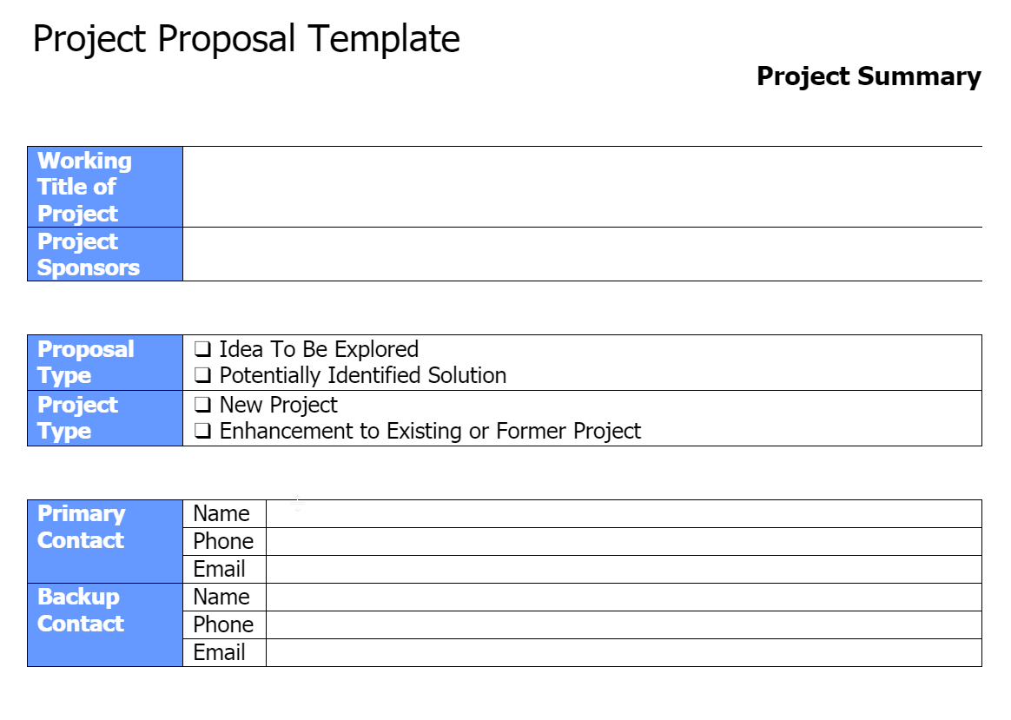
PM101 – Project Proposal Walkthrough
Notes:
Feedback from survey: traditional courses very dry, decided to teach a course more immersive

Slide 17
PM101 – Project Proposal Walkthrough
Executive Summary
Please provide a summary of the information detailed throughout this project proposal.
Statement of Need
Discuss the needs or opportunities to be addressed by this project. In your discussion, describe and position these needs or opportunities within the context of your organizational environment. Internal factors, as well as external ones, should be considered.
Project Goals
Identify the goals of the project. Discuss what is to be achieved and the expected/desired outcomes of this project.
Constraints
Talk about constraints that could affect the development, implementation, and/or end outcomes of this project. Consider such factors as experience, knowledge, skill sets, budgetary resources, time, competitive environment, and existing investments.
Notes:
Feedback from survey: traditional courses very dry, decided to teach a course more immersive

Slide 18
PM101 – Project Proposal Walkthrough
Requirements
Given your operational context, describe what needs to be in place during the project and afterwards in order for the project to be successful. In your discussion, consider the constraints you identified above and, if necessary, define requirements to compensate for constraints.
Time vs. Relevancy
In order for this project to be relevant within your operation, satisfy the needs and opportunities defined, and achieve stated project goals, what would be the desired timeline for the project? What do you think is the longevity or useful life of the solution?
Impact: Costs & Risks
Discuss the expected impact of the project and its expected outcomes. Provide detail on expected and potential costs and risks. Also, consider both one-time as well as on-going costs and risks (i.e., maintenance and support). Wherever possible, quantify the impact of the solution.
In your discussion speak to the following areas of impact: (1) positioning to take advantage of other opportunities; (2) effect on business processes and workflow; (3) staffing (number of staff required, training, redefinition of roles); (4) effect on client base/end users; (5) budget (i.e., incremental costs needed; potential savings); (6) competitive advantage or standing.
Notes:
Feedback from survey: traditional courses very dry, decided to teach a course more immersive

Slide 19
PM101 – Project Proposal Walkthrough
Impact: Benefits & Opportunities
Discuss the expected impact of the project and its expected outcomes. Provide detail on expected and potential benefits and opportunities. Wherever possible, quantify the impact of the solution.
In your discussion talk about the following areas of impact: (1) positioning to take advantage of other opportunities; (2) effect on business processes and workflow; (3) staffing (number of staff required, training, redefinition of roles); (4) effect on client base/end users; (5) budget (i.e., incremental costs needed; potential savings); (6) competitive advantage or standing.
Alternative Impact
Using the discussion points above in the Impact section, describe the alternative impact on your unit and its constituents if this project is not pursued?
Notes:
Feedback from survey: traditional courses very dry, decided to teach a course more immersive

Slide 20
PM101 – Project Proposal Walkthrough
Project Fit
Discuss how this project fits within the strategies defined by your unit. How does this project align with your local unit’s objectives and mission? Do you see potential opportunities for this project to benefit other functional areas within the organization or across the University?
Evaluation and Measurement
Propose criteria that might be used in defining and evaluating the success of this project and its end outcomes. What measurement standards are available to determine if the project is a success and the impact of its end outcomes? What benchmarks can be set up to determine the short-term and long-term efficacy of the project? Consider in your discussion the goals, requirements, and impact defined above.
Notes:
Feedback from survey: traditional courses very dry, decided to teach a course more immersive

Slide 21
PM101 – Project Proposal Walkthrough
Potential Solution
At a high level, describe a potential solution that would satisfy the goals and requirements defined above.
Alternative Solutions
Do you know of any alternative solutions that satisfy the goals and requirements of this project (either fully or partially)? If so, have they been explored? Discuss why this proposal has been submitted in lieu of alternative solutions.
Contingency Plan
If the proposed project is critical to your operations, please discuss what contingency plans could be put into place in the event that the project or its end outcomes are not successful.
Notes:
Feedback from survey: traditional courses very dry, decided to teach a course more immersive

Slide 22
PM101 – Sample Proposal
Title: "Discovery Day" by the Monroe Township Public Library:
​Description:
  A day for patrons to come and discover a new skill such as how to make coffee using a French press or how to sew on a button, etc. We will have different “skill stations” throughout the library
Notes:
Feedback from survey: traditional courses very dry, decided to teach a course more immersive

Slide 23
PM101 – Q&A
Notes:
Feedback from survey: traditional courses very dry, decided to teach a course more immersive

