Slide 1
21st Century Libraries Are For Everyone:
Serving the Needs of our Most Vulnerable Community Members
Instructor
Loida Garcia-Febo
International Library Consultant

Slide 2
Goals
Build your library service profile identifying vulnerable populations in the communities served.
Implement creative marketing and communications strategies to reach out to these populations.
Implement equity, diversity and inclusion practices to serve vulnerable populations.
Advocate for providing library services to all in our communities.

Slide 3
Implementing equity, diversity and inclusion practices to serve vulnerable populations.
Advocating for providing library services to all in our communities.

Slide 4
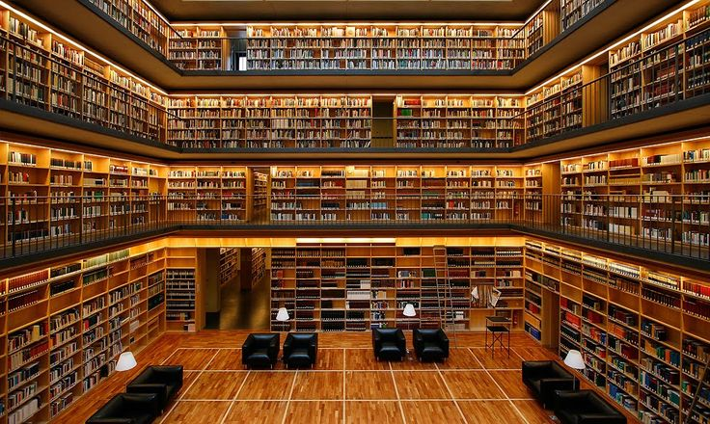
Article 19
Everyone has the right to freedom of opinion and expression; this right includes freedom to hold opinions without interference and
to seek, receive and impart information
and ideas through any media and regardless of frontiers.

Slide 5
IFLA/UNESCO Multicultural Library Manifesto
Principles
Each individual in our global society has the right to a full range of library and information services. In addressing cultural and linguistic diversity, libraries should:
serve all members of the community without discrimination based on cultural and linguistic heritage;
provide information in appropriate languages and scripts;
give access to a broad range of materials and services reflecting all communities and needs;
employ staff to reflect the diversity of the community, who are trained to work with and serve diverse communities. http://www.ifla.org/node/8976

Slide 6
IFLA/UNESCO Multicultural Library Manifesto
Principles
Library and information services in a culturally and linguistically diverse context include both the provision of services to all types of library users and the provision of library services specifically targeted to underserved cultural and linguistic groups. Special attention should be paid to groups which are often marginalized in culturally diverse societies: minorities, asylum seekers and refugees, residents with a temporary residence permit, migrant workers, and indigenous communities. http://www.ifla.org/node/8976

Slide 7
Role and Purpose
As libraries serve diverse interests and communities, they function as learning, cultural, and information centres. In addressing cultural and linguistic diversity, library services are driven by their commitment to the principles of fundamental freedoms and equity of access to information and knowledge for all, in the respect of cultural identity and values.
IFLA Multicultural Library Manifesto, 2008.
7
Notes:
7

Slide 8
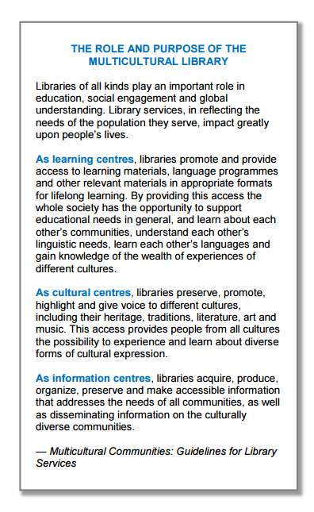
http://tinyurl.com/p3cb9zb

Slide 9
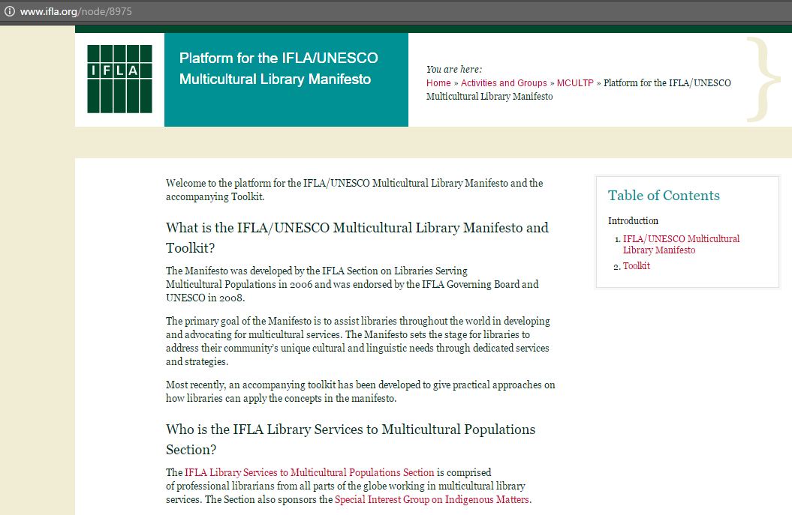
IFLA Multicultural Manifesto Toolkit
http://www.ifla.org/node/9284

Slide 10
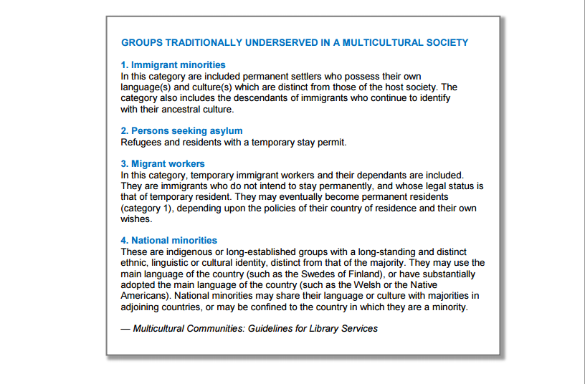
http://tinyurl.com/p3cb9zb

Slide 11

Acceptance of GLBT people in mainstream
American society has been steadily growing.
However, library materials, programs, and
displays related to sexual orientation and
gender identity still cause controversy. The fear
of a challenge may cause some librarians to
be deterred from buying materials or including
services for GLBT people in their service profile;
failing to provide these resources in ways that
can be easily used by vulnerable populations are
forms of censorship and discrimination.
Every community has a GLBT population and
GLBT families. The job of librarians, whether
serving adults, teens, children, students, parents,
or others, is to make libraries welcoming and
open to all.
http://www.ala.org/glbtrt/sites/ala.org.glbtrt/files/content/professionaltools/160309-glbtrt-open-to-all-toolkit-online.pdf

Slide 12
IFLA’s LGBTQ Users Special Interest Group
Mission
As part of our professional commitment to provide access to information, librarians are charged to support the full range of users’ informational needs including those of lesbians, gay, bisexual, transgender, queer/questioning (LGBTQ) people.
This SIG will enable libraries to consider topics including professional attitudes, outreach, privacy, programming, and effective practice in acquiring and collecting materials of importance to LGBTQ people and allies. This includes literature, academic texts, materials of importance to LGTBQ youth and families, and other works that encourage thinking critically about issues of sexuality and gender identity. Dialogue to support librarians in addressing concerns raised about LGBTQ library services will also be encouraged within the SIG.
https://www.ifla.org/about-lgbtq

Slide 13

Library Services
Libraries must not discriminate against individuals with disabilities and shall ensure that individuals with disabilities have equal access to library resources.
To ensure such access, libraries may provide individuals with disabilities with services such as extended loan periods, waived late fines, extended reserve periods, library cards for proxies, books by mail, reference services by fax or email, home delivery service, remote access to the OPAC, remote electronic access to library resources, volunteer readers in the library, volunteer technology assistants in the library, American Sign Language (ASL) interpreter or realtime captioning at library programs, and radio reading services.
Libraries should include persons with disabilities as participants in the planning, implementing, and evaluating of library services, programs, and facilities.

Slide 14
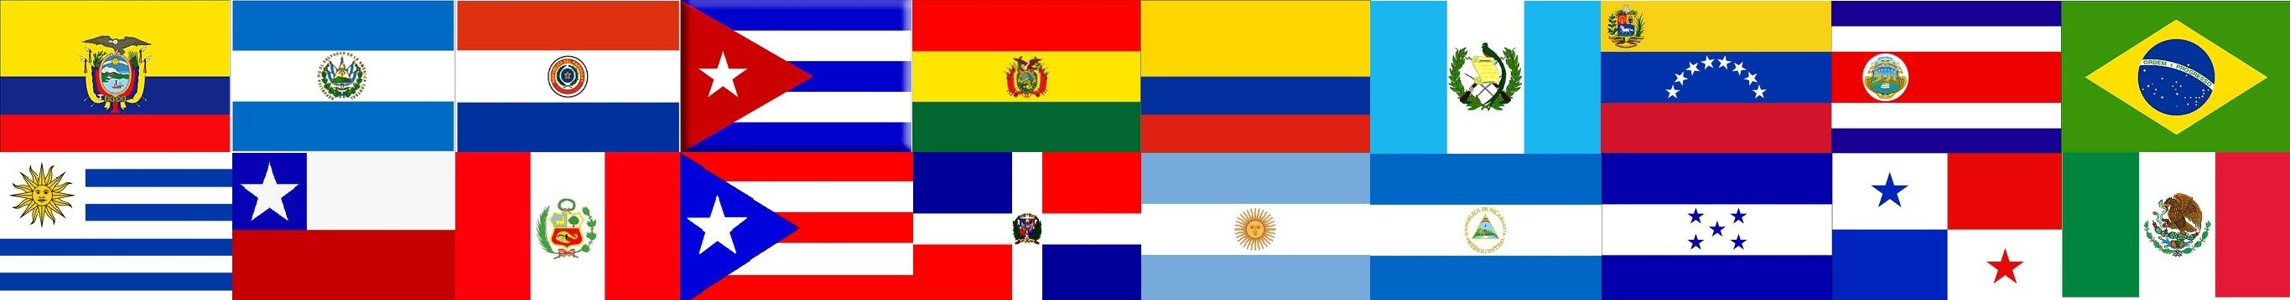
Knowing your library service area
& your community

Slide 15
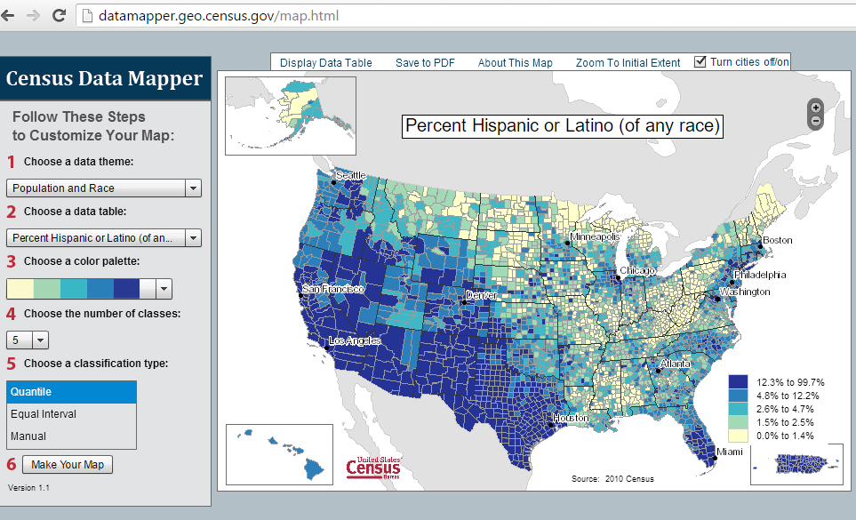

Slide 16
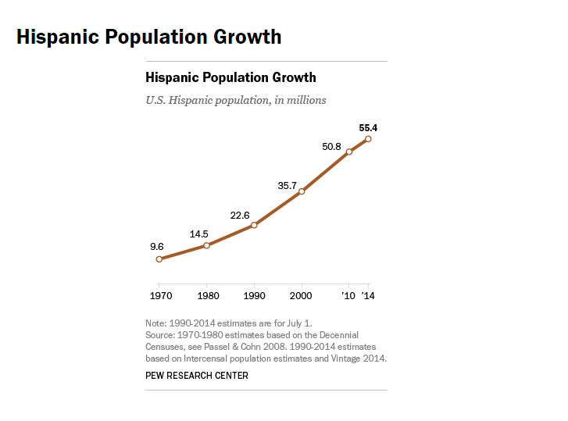
http://www.pewresearch.org/fact-tank/2015/06/25/u-s-hispanic-population-growth-surge-cools/ft_15-06-25_hispanic_trend/

Slide 17
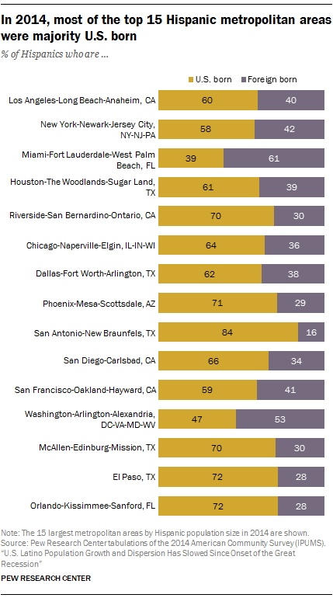
http://www.pewhispanic.org/2016/09/08/latino-population-growth-and-dispersion-has-slowed-since-the-onset-of-the-great-recession/ph_2016-09-08_geography-28/

Slide 18
Facts: Hispanics in the U.S.*
55 million, Hispanic population in the USA. 17% of the nation’s total population
States with a population of 1 million or more Hispanic residents: Arizona, California, Colorado, Florida, Illinois, New Jersey, New York and Texas
12.2 million, Number of Hispanic households in the U.S.
73.3%, Percentage of Hispanics 5 and older who spoke Spanish at home. (34% of U.S. residents 5 and older who spoke Spanish at home)
*https://www.census.gov/newsroom/facts-for-features/2015/cb15-ff18.html

Slide 19
Facts: Hispanics in the U.S.*
$40,963 The median income of Hispanic households
64.7%, The percentage of Hispanics 25 and older that had at least a high school education
67.0%, Percentage of Hispanics or Latinos 16 and older who were in the civilian labor force
1.2 million, The number of Hispanics or Latinos 18 and older who are veterans of the U.S. armed forces
8.4%, The percentage of voters in the 2012 presidential election who were Hispanic
*https://www.census.gov/newsroom/facts-for-features/2015/cb15-ff18.html

Slide 20
Discussion Question:
Which countries do you think are represented in your community?

Slide 21
Discussion Question:
Which countries are represented among your library patrons?

Slide 22
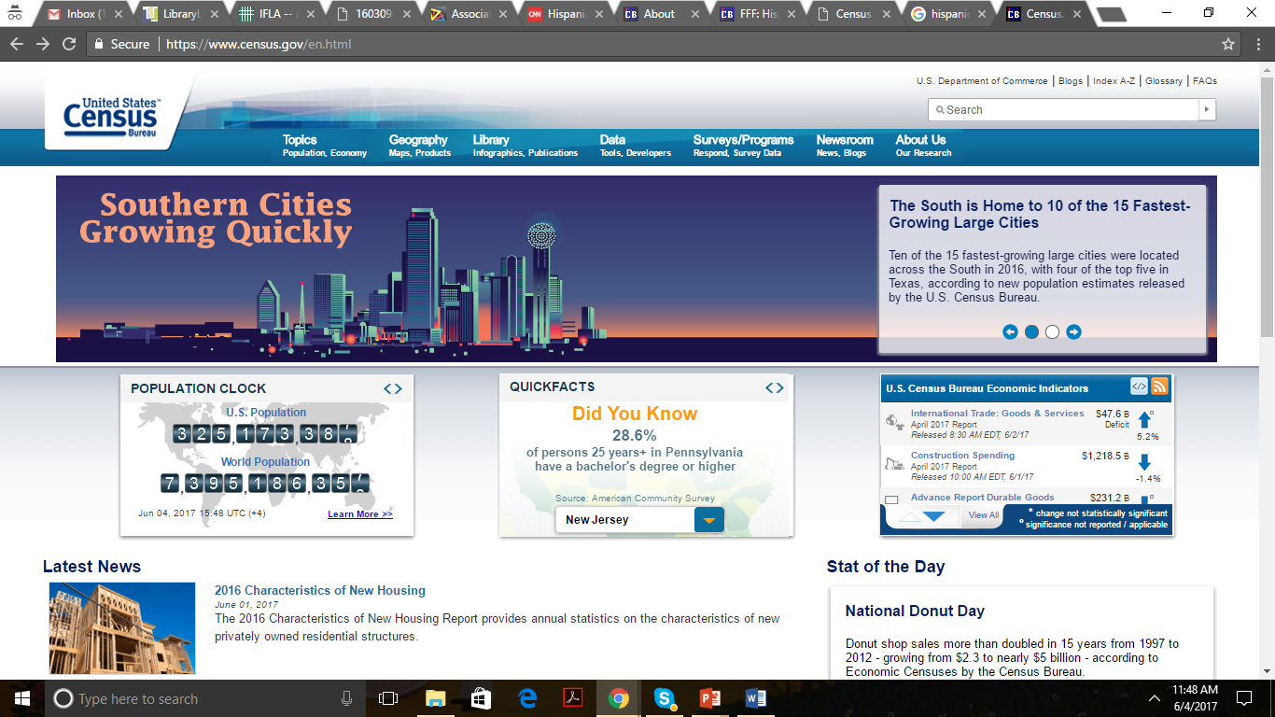

Slide 23
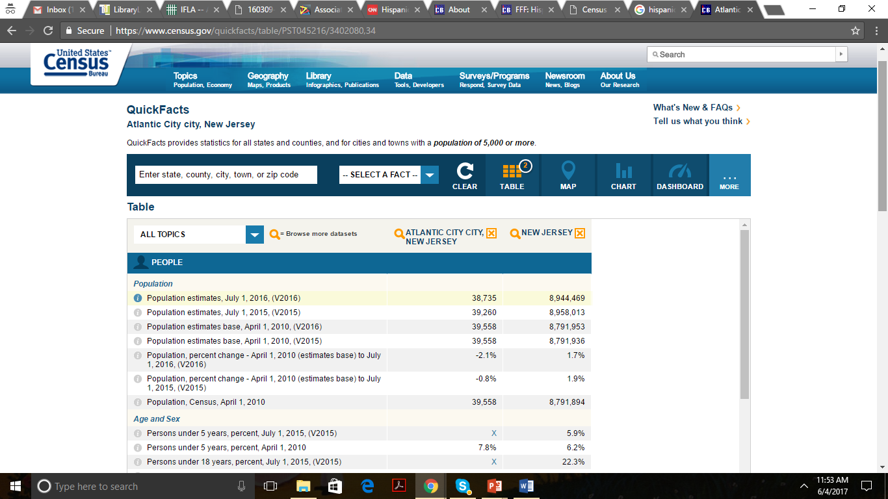

Slide 24
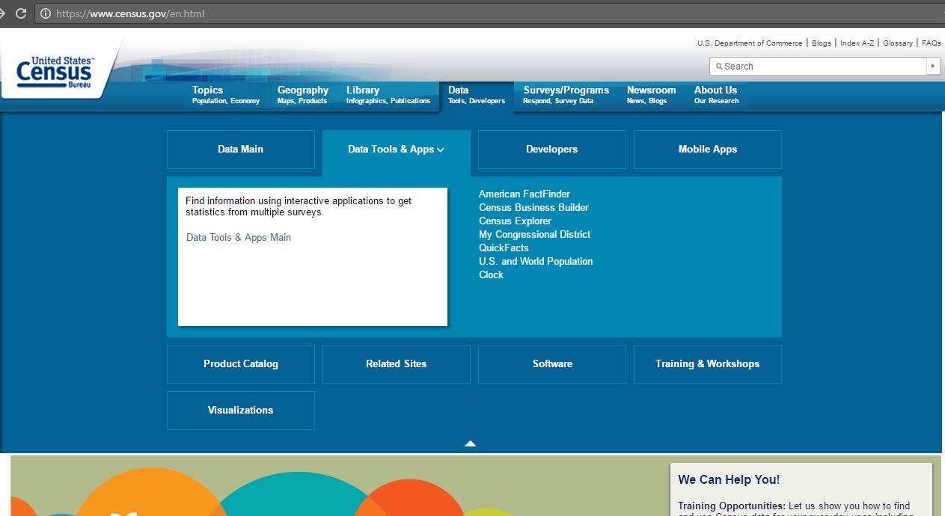

Slide 25
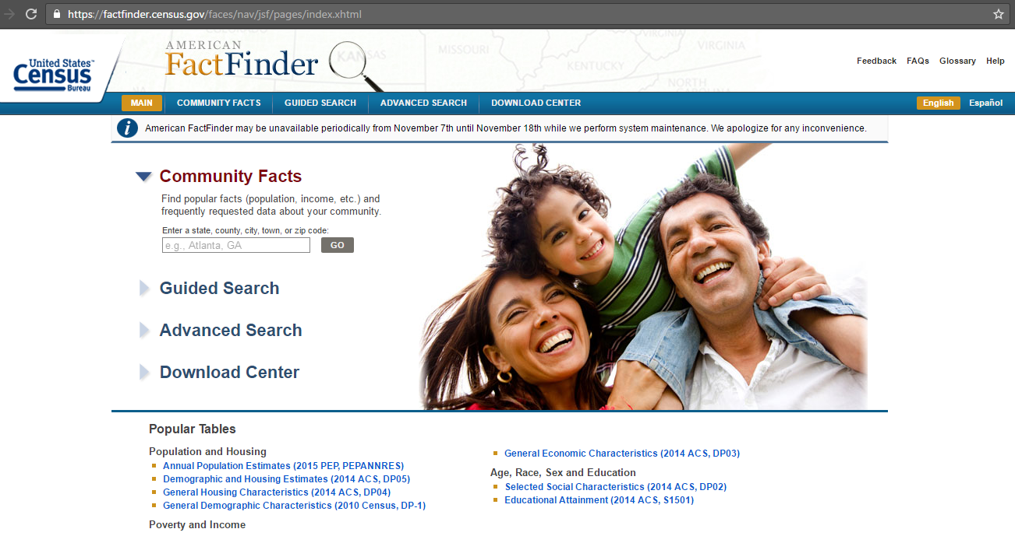

Slide 26
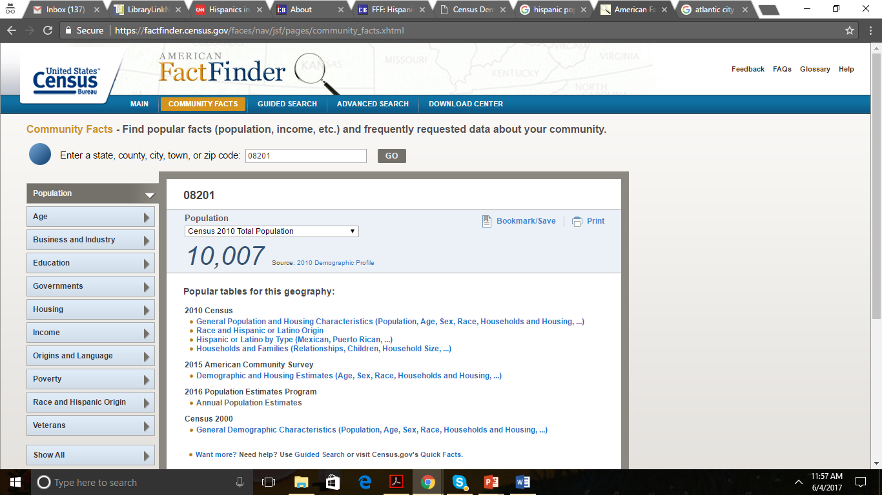

Slide 27
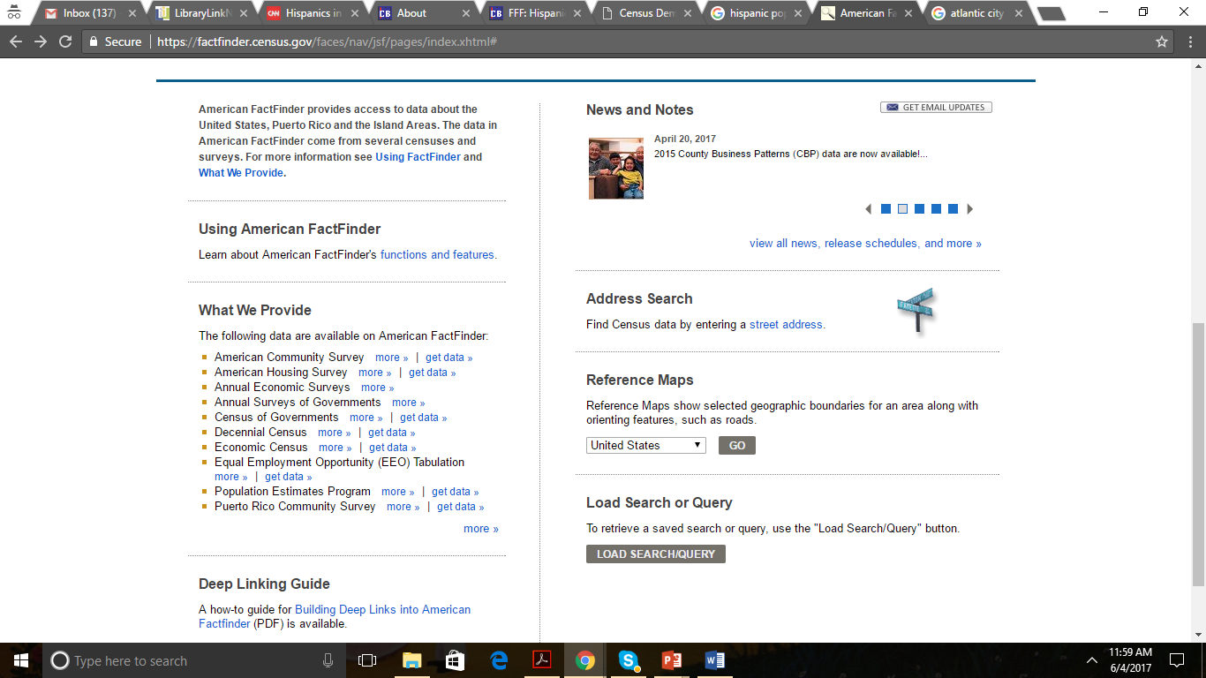


Slide 28
Additional Resources
Department of City Planning
Department of Education
Department of Health
University/College
Journals
Community Organizations
Research

Slide 29
Using data to develop a customized library profile framework

Slide 30
Resources
Demographics
Community Based Organizations
Not-for-profit organizations
Community Leaders
Community Signage
Front-Line Library Staff

Slide 31
Important Points
Preferences, Likes
Popular hobbies
Education levels
Usage of technology devices
Level of reading and writing in X language - and in English.
Schedules
Time in the USA

Slide 32
Who
What
Where

Slide 33
Library Profile
Preferences, Likes
Popular hobbies
Education levels
Usage of technology devices
Level of reading and writing in X language - and in English.
Schedules
Time in the USA
Demographics

Slide 34
Community Assessment*
What is their perception of the library and the services that the library provides?
Are there obstacles that prevent Latinos (vulnerable groups) from using the Library?
What are important holidays, cultural events and traditions? How are they celebrated, observed?
What are the local concerns of Latinos, and what resources can the library provide to help address these concerns?
What kind of programs would be of interest in this community?
Would this community rather read in Spanish, English or both?
*From Byrd, S. M. Bienvenidos! Welcome! A Handy Resource Guide for Marketing your Library to Latinos. Chicago: American Library Association, 2005, P. 9-10.

Slide 35
Community Assessment*
What media venues are most effective in reaching this target population?
What word-of-mouth networks are most responsible for spreading information in the Latino community?
Where do Latinos gather and share information in the community?
Who are the community leaders and connectors who can help build a bridge between the library and the Latino community?
*From Byrd, S. M. Bienvenidos! Welcome! A Handy Resource Guide for Marketing your Library to Latinos. Chicago: American Library Association, 2005, P. 9-10.

Slide 36

Outreach and Partnerships
Collaboration is key! Every community is different.
You may have social service organizations or fraternal
groups in your area to connect with.
• In a larger city or urban area, check for a GLBT
Chamber of Commerce. In a more rural community,
GLBT-related organizations may be few and distant.
• In schools, there are counselors, supportive
instructors, and possibly gay-straight alliance groups
as well as Q Centers directly on campus or in the
community.
Set up a meeting with your local GLBT community
groups to discuss implementing programs, for
example, a specialized program, a film screening,
a book discussion, etc. GLBT populations are often
misrepresented, so it is important to research and ask
questions. Discuss your goals and ideas, and be open to
critiques and suggestions from community members.
http://www.ala.org/glbtrt/sites/ala.org.glbtrt/files/content/professionaltools/160309-glbtrt-open-to-all-toolkit-online.pdf

Slide 37
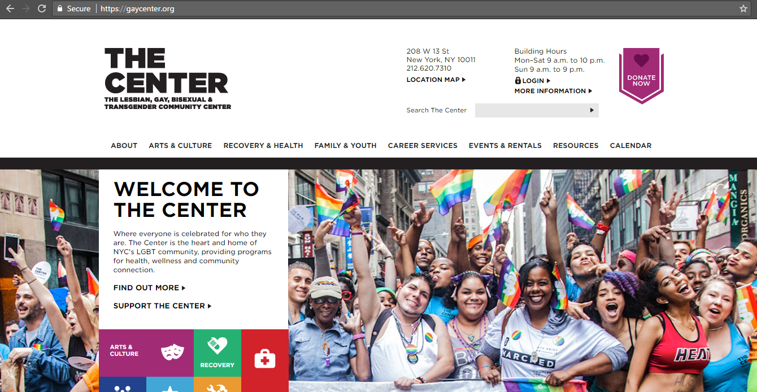

Slide 38
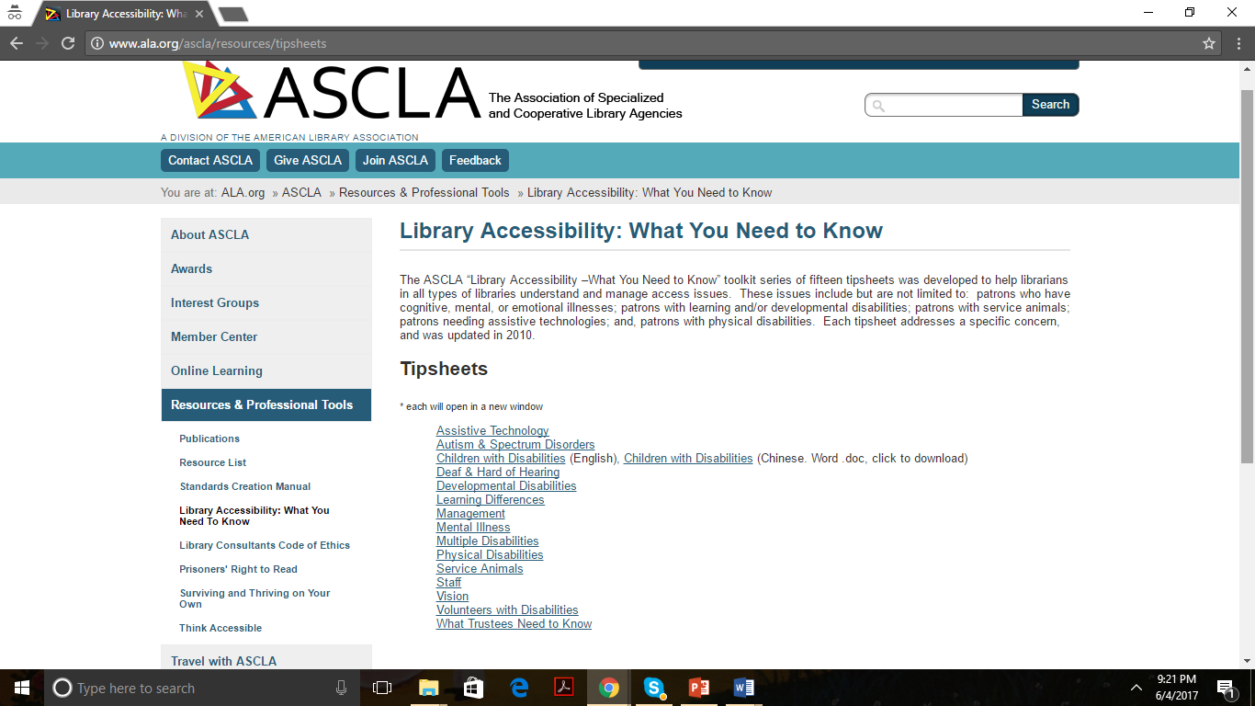

Slide 39
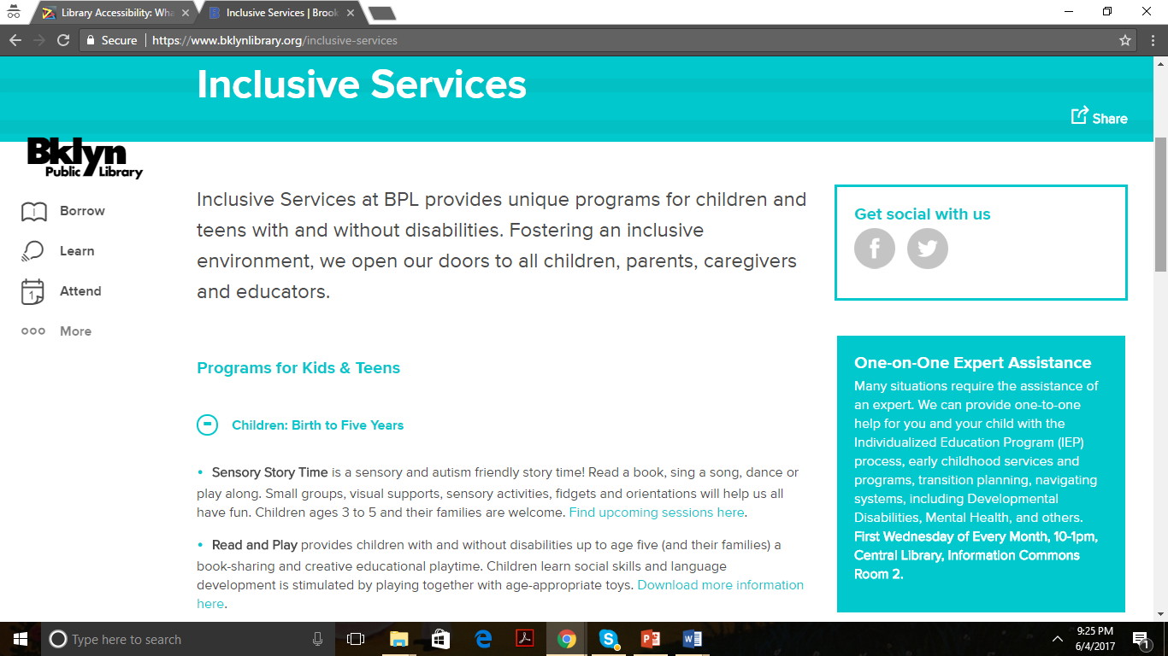

Slide 40
Developing collections, programs & services

Slide 41
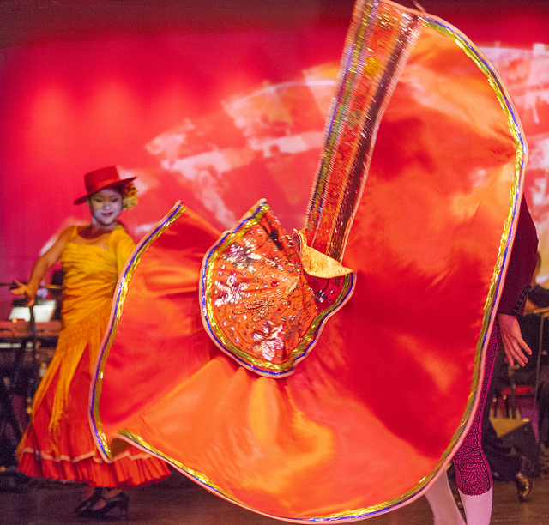
Pete Self

Slide 42
Programs & Services
Countries of origin
Older adult, adults, teens, children, babies
Interests, hobbies
Housing: apartments, houses
Employed, unemployed
Health conditions
Persons with disabilities
LGBT

Slide 43
Discussion Question:
At what time have you noticed more Spanish speakers (vulnerable groups) visiting the library?

Slide 44
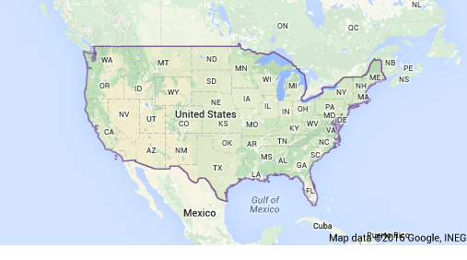
Loida Garcia-Febo research:
Public Libraries serving Immigrants and Refugees

Slide 45
Loida Garcia-Febo research:
Public Libraries serving Immigrants and Refugees

Slide 46
Loida Garcia-Febo research:
Public Libraries serving Immigrants and Refugees

Slide 47
Services Provided to Immigrants & Refugees
Classes to learn English
Weekly conversation clubs in different languages
Pre-GED and GED
Orientation to their new country
Classes to guide professional adults
Panel discussions, e.g. This Muslim-American Life
Cultural Salons including books, food and cultural exchanges
Film or Book Series
Loida Garcia-Febo research:
Public Libraries serving Immigrants and Refugees

Slide 48
Top Three Topics:
English classes
Life skills programs
Cultural programs
Technology workshops
Citizenship*
Job skills*
Loida Garcia-Febo research:
Public Libraries serving Immigrants and Refugees

Slide 49
Collections

Slide 50
The U.S. Citizenship and Immigration Services recommend ways to compile information to build collections:
• Consulting with other libraries serving substantial numbers of immigrants
• Holding focus groups with immigrants
• Consulting with community agencies that serve immigrants
• Conducting an immigrant needs assessment as part of a general community needs assessment
Programs:
English language instructional materials
• Citizenship and immigration resources
• Tutor resource materials
• Dictionaries in multiple languages
• Novels translated into other languages
• “How-to” books in multiple languages
• Periodicals and newspapers in different languages
• Information on various ethnic groups and cultures
• Original source materials
• Music and video resources
• Forms, brochures, and directories for community

Slide 51
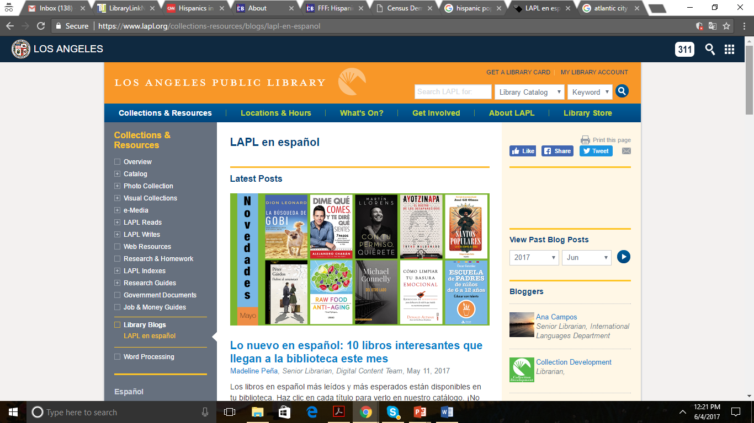

Slide 52
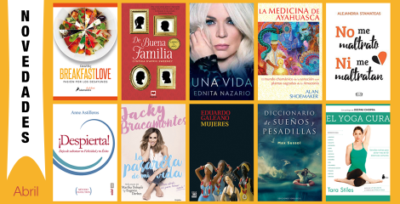
https://www.lapl.org/collections-resources/blogs/lapl-en-espanol/novedades-en-espa%C3%B1ol-abril-2017

Slide 53
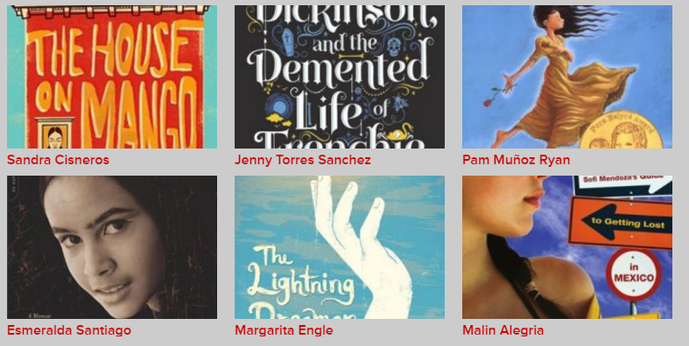
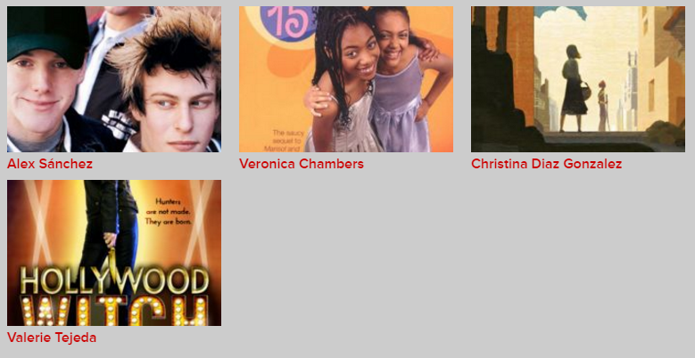
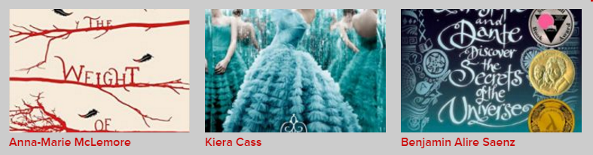
YA Literature
http://www.latina.com/entertainment/book-club/latino-young-adult-authors-know#4

Slide 54
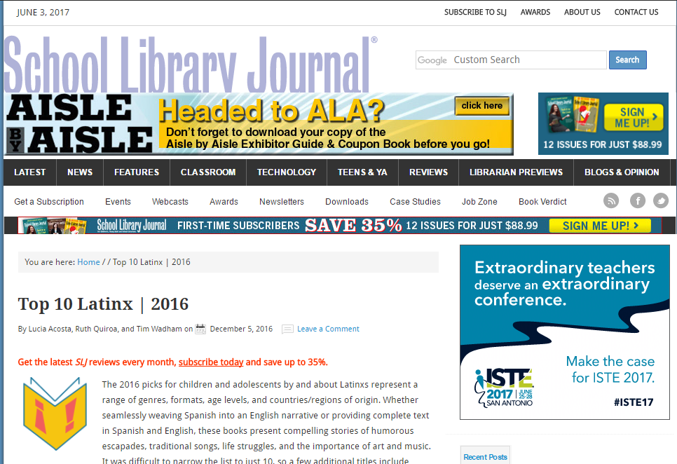
http://www.slj.com/2016/12/reviews/best-of/top-10-latinx-2016/

Slide 55
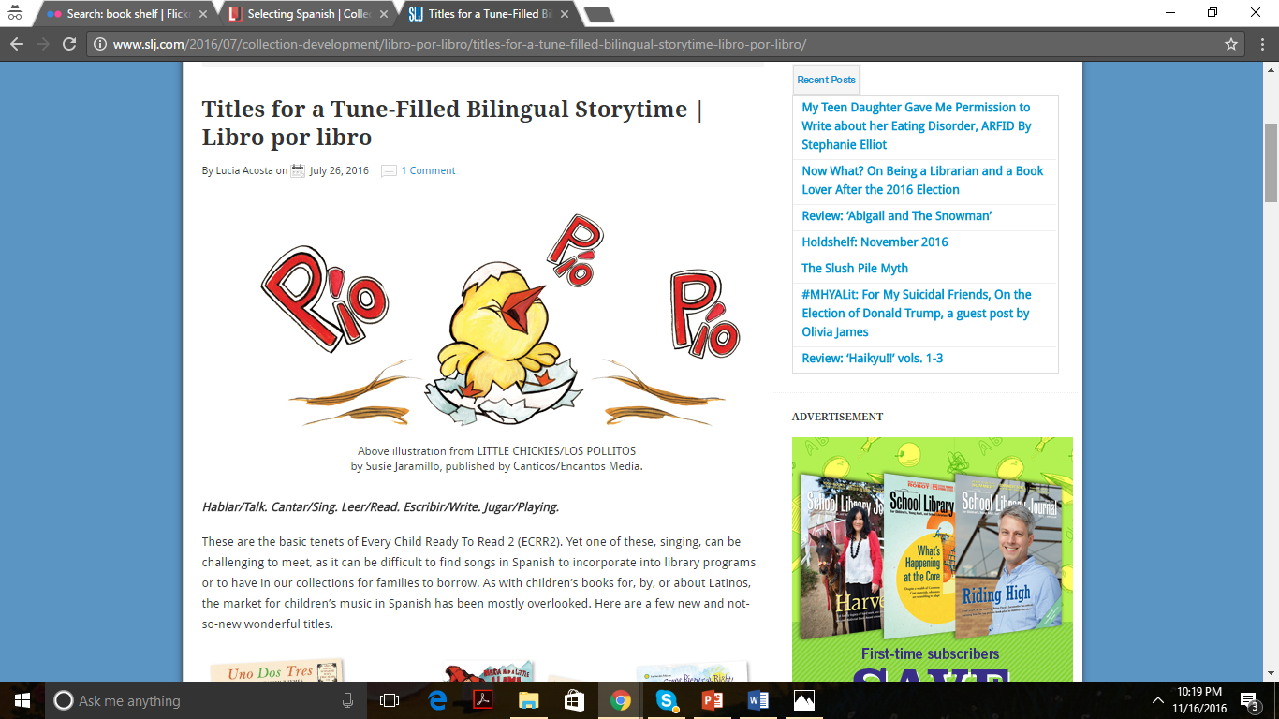
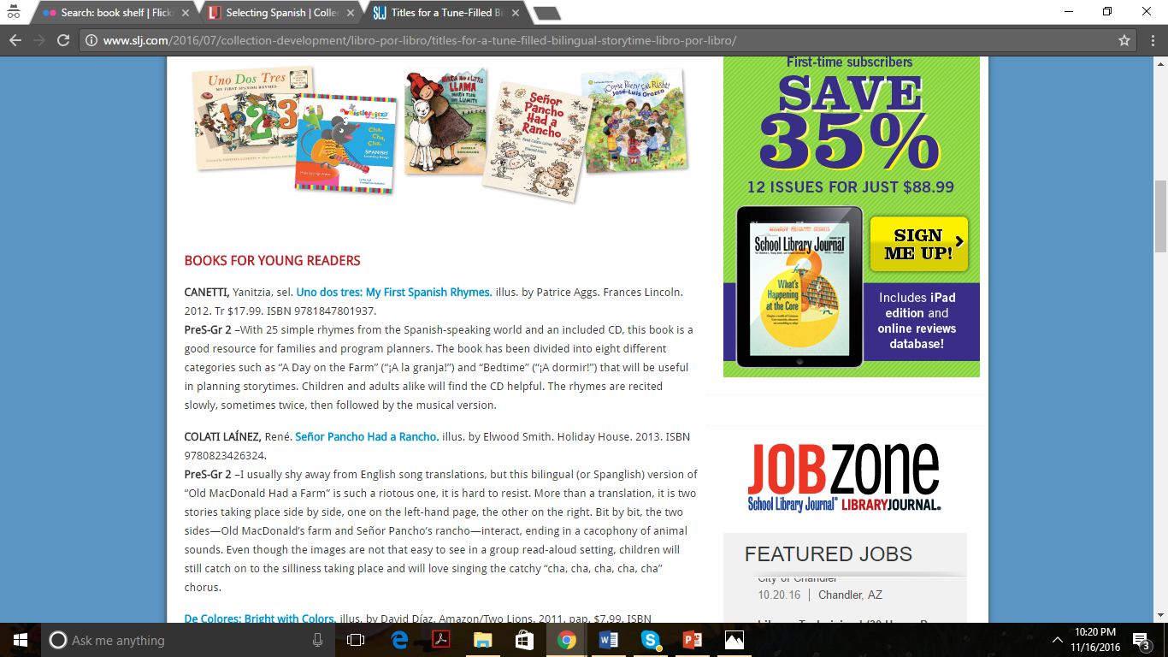
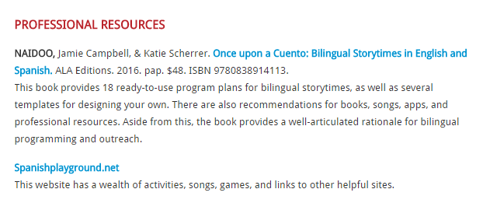
http://www.slj.com/2016/07/collection-development/libro-por-libro/titles-for-a-tune-filled-bilingual-storytime-libro-por-libro/

Slide 56
Collections
Printed
Books, Newspapers, Magazines
Digital
Books, Music,
Movies,
Databases
Online
Blogs, Reviews, Communities, Self-published/ recorded

Slide 57
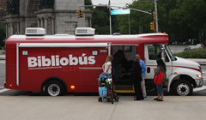
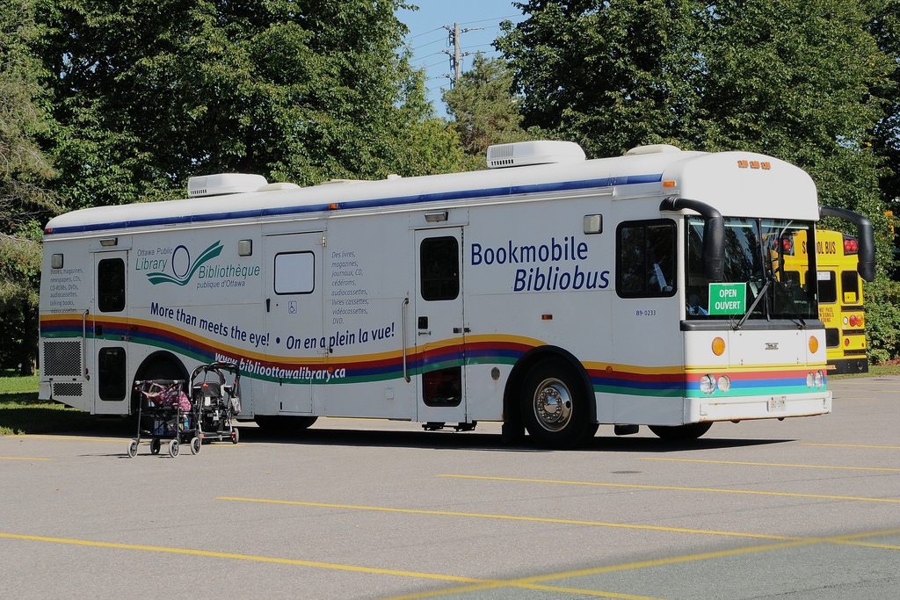
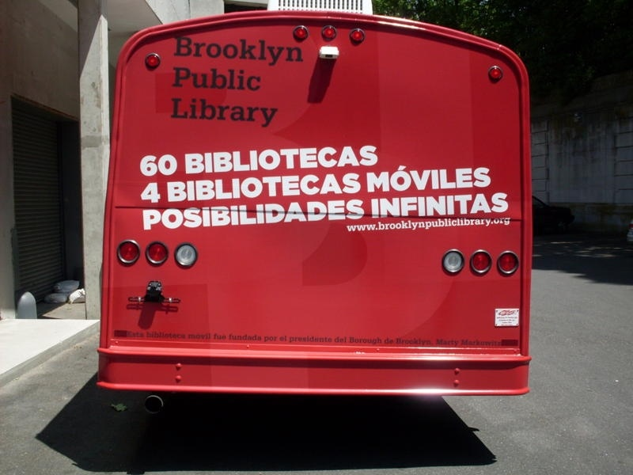
Brooklyn Public Library
http://www.bklynlibrary.org/only-bpl/bibliobus
Ottawa Public Library
https://www.flickr.com/photos/71639059@N00/15397694407

Slide 58
Programs & Services
Countries of origin
Older adult, adults, teens, children, babies
Interests, hobbies
Housing: apartments, houses
Employed, unemployed
Health conditions
Persons with disabilities
LGBT

Slide 59
Children
Storytelling
Crafts
Festivals
Hispanic Heritage Month
Dia de las Madres/
Mother’s Day
Celebrating culture
Adults
Film Festival
Author Talks
Various
Dance
Concerts

Slide 60

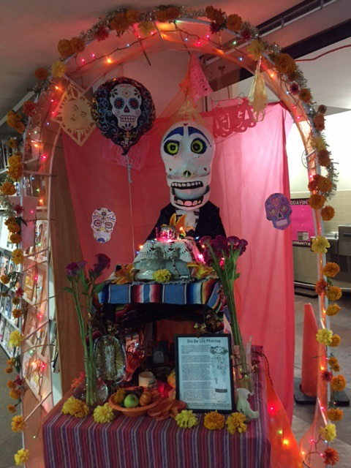

Lafayette Public Library
Los Angeles Public Library

Slide 61
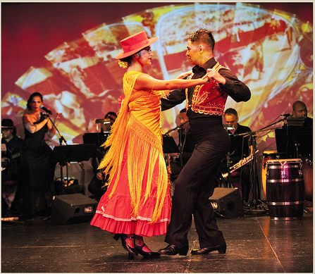
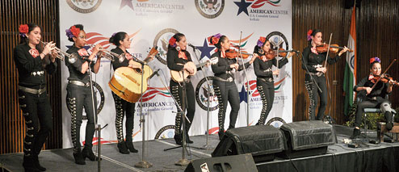
Pete Self
Mariachi Flor de Toloache

Slide 62
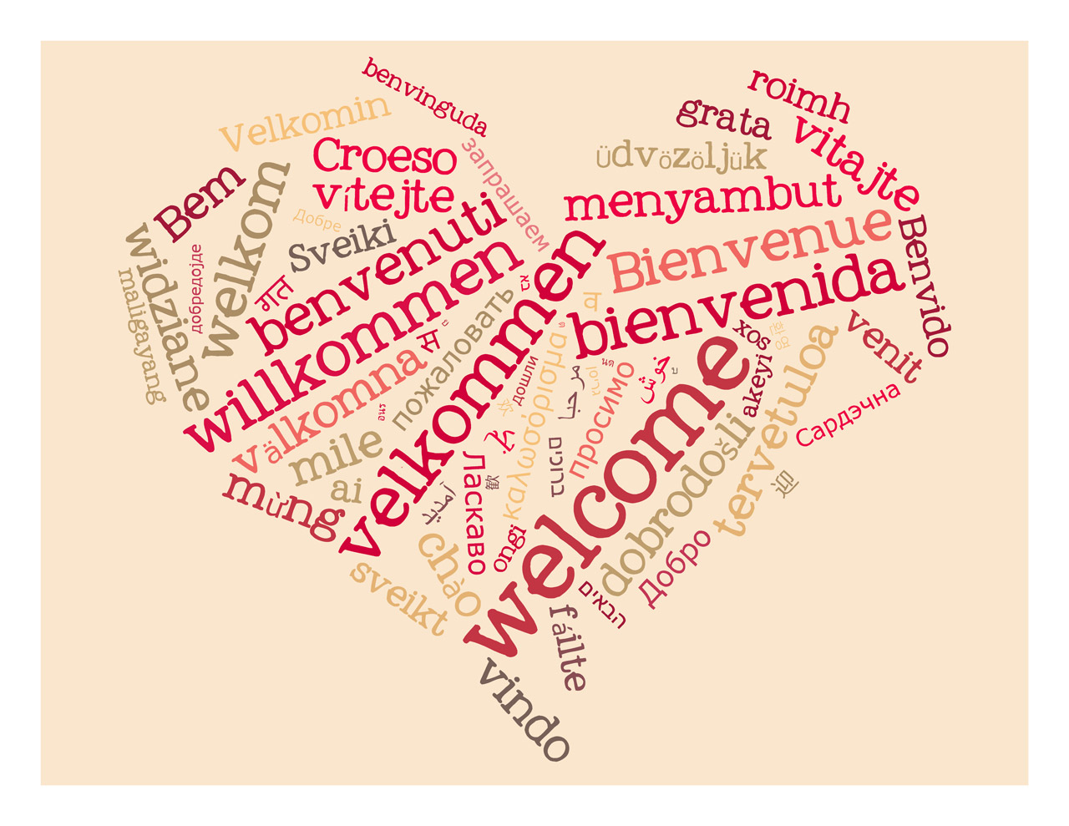

Slide 63
Health
Diabetes
Cancer
Housing
Tenants’ Rights
How to buy a home
Social Programs
Children
Public School System
Homework
Citizenship
Green Card
Naturalization

Slide 64
Additional Programs
Community resources seminar
“American Issues” and civics discussion groups
Cultural activities and holiday events
On-site English language and citizenship classes
Conversation-practice groups
Free seminars by immigration lawyers
Book clubs
Voter education seminars
Health seminars
Family literacy programs
Computer literacy programs

Slide 65


Slide 66
Internet
Computers
Tech Classes
Jobs
Counselors
Resume/ Coverletter/ Interview
Services
Education
High School
Kinder
Online classes
Community Forums
Financial Literacy

Slide 67
Based on the information we have shared so far, discuss one social program and one cultural program that would reflect your community’s interests.

Slide 68
Marketing & Outreach

Slide 69
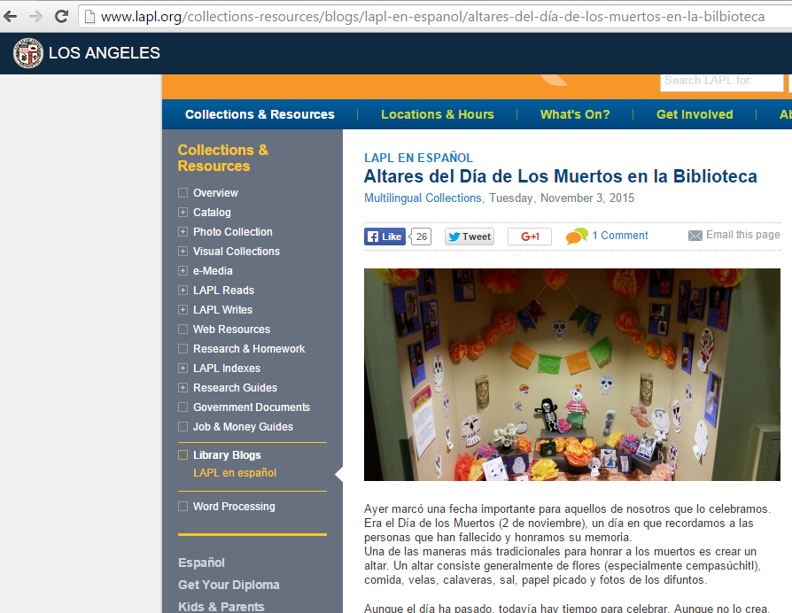

Slide 70
http://www.lapl.org/collections-resources/blogs/lapl-en-espanol/altares-del-d%C3%ADa-de-los-muertos-en-la-bilbioteca

Slide 71
Brooklyn Public Library
http://www.bklynlibrary.org/only-bpl/bibliobus
Ottawa Public Library
https://www.flickr.com/photos/71639059@N00/15397694407

Slide 72
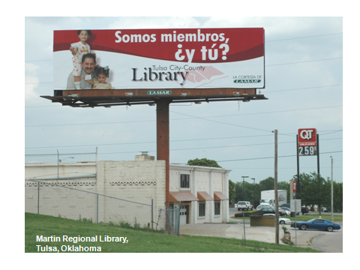

Slide 73
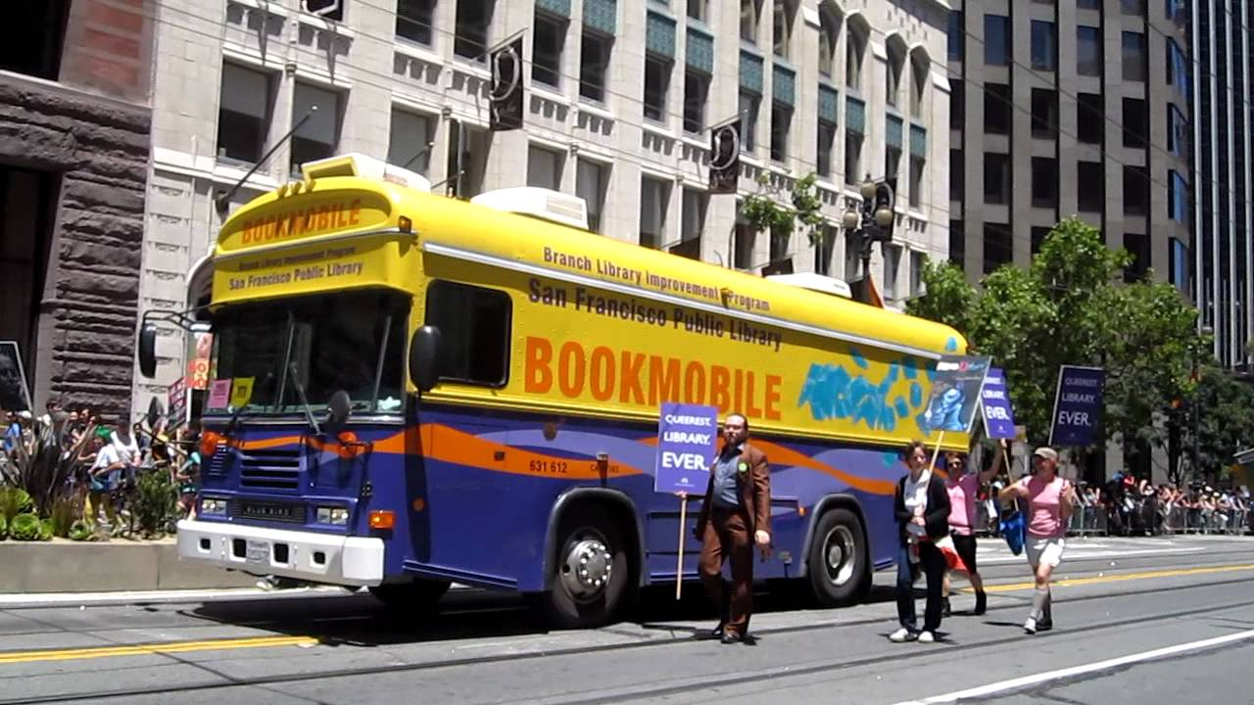
https://www.youtube.com/watch?v=NJubpkTOxQc

Slide 74
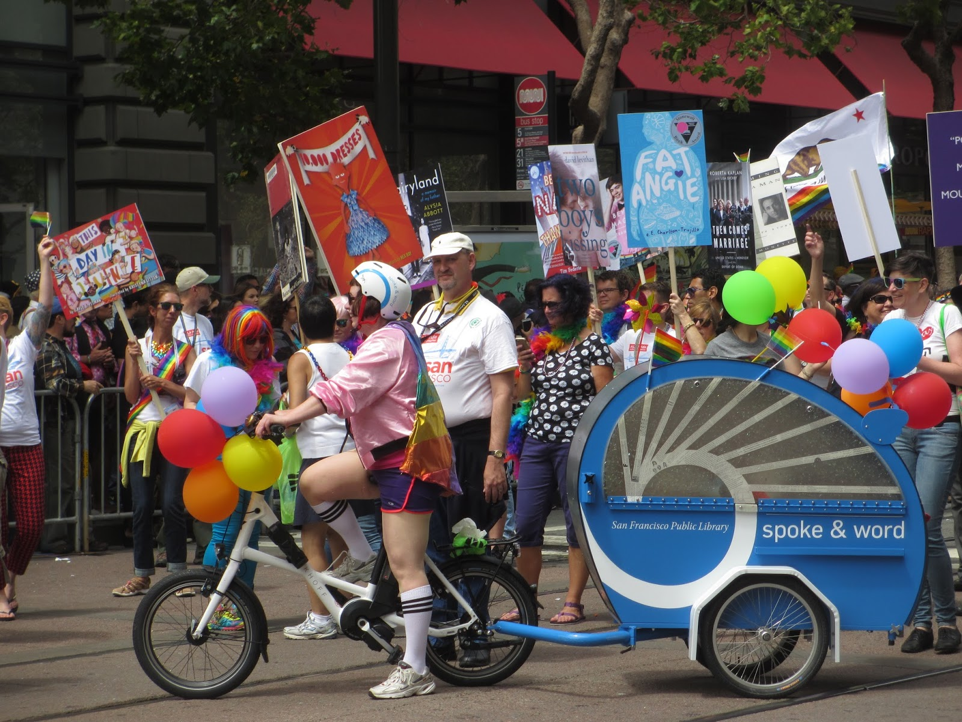

Slide 75

Created by Rebecca McCorkindale: https://hafuboti.com/2017/02/02/libraries-are-for-everyone/

Slide 76
Develop Strategies
Local media: newspapers, websites, radio, TV
Social media: Facebook, Twitter, YouTube, Flickr, Instagram
Word-of-Mouth
Door-to-Door
Community Fairs and Events
Local churches, community organizations, schools, stores, parks
Regional Coalitions
Citywide Events, Meetings, Conferences

Slide 77
Marketing & Outreach
Local Media, Social Media, Word-of-Mouth,
Door-to- Door
Community Fairs and Events
Local churches, community organizations, schools, stores, parks
Regional Coalitions
Citywide Events, Meetings, Conferences

Slide 78
Discussion Question:
How could you publicize your library’s programs and services for Spanish speakers? (vulnerable groups)

Slide 79
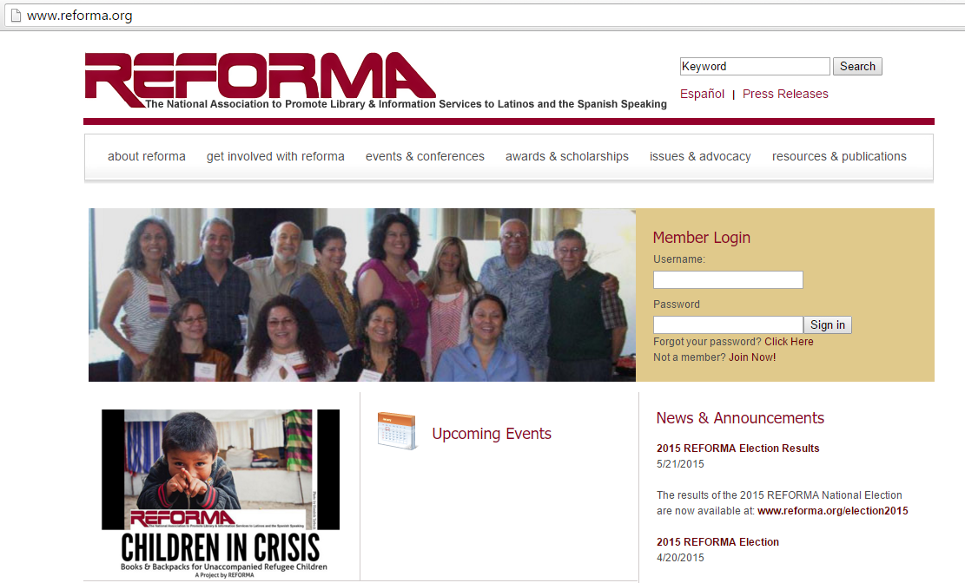

Slide 80
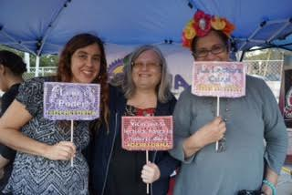
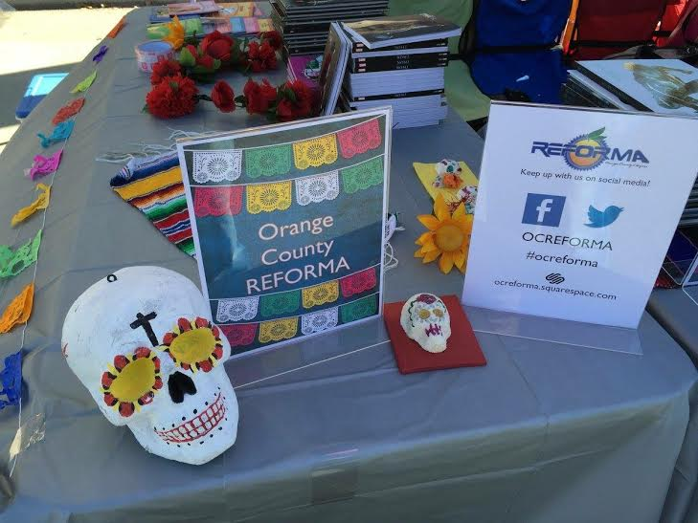
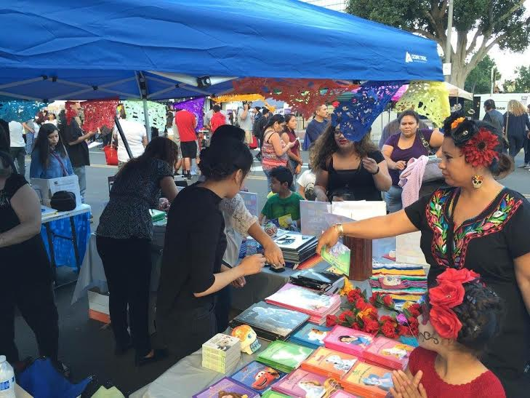
Photos by REFORMA Orange County Chapter

Slide 81


Slide 82
Library Models

Slide 83
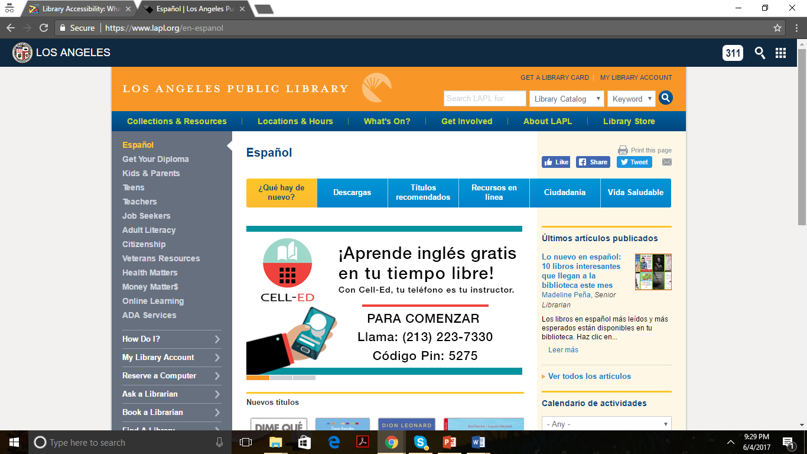

Slide 84
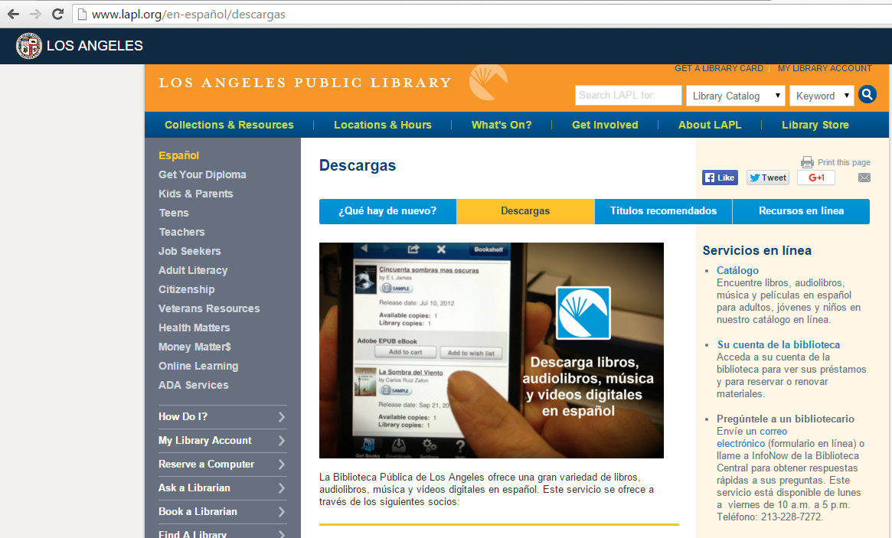

Slide 85
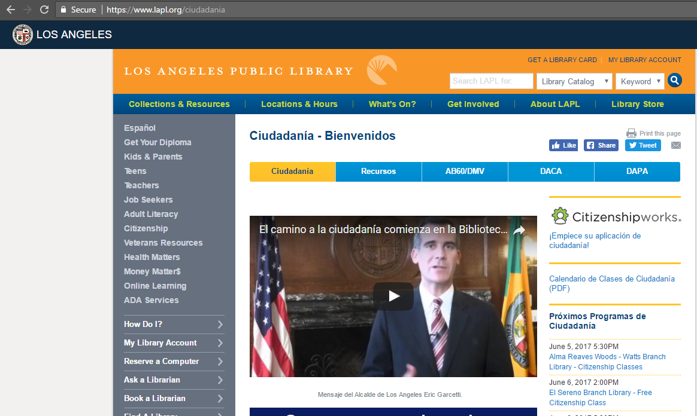

Slide 86
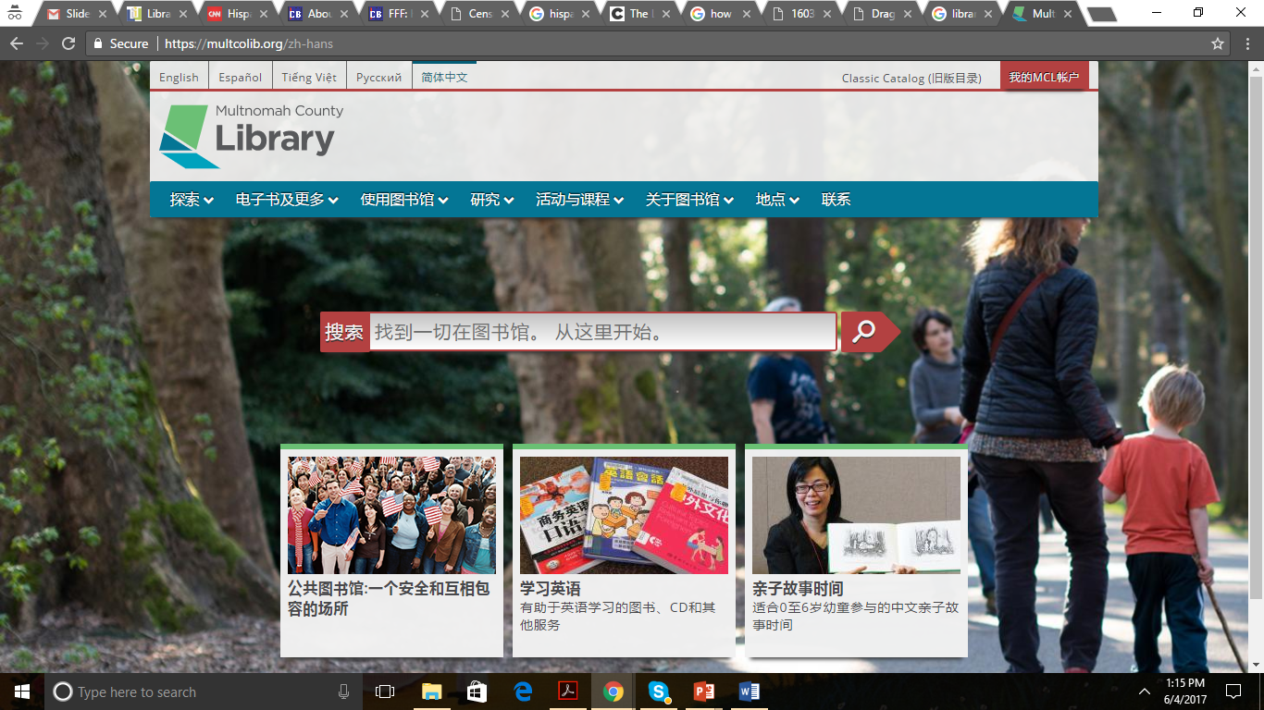

Slide 87
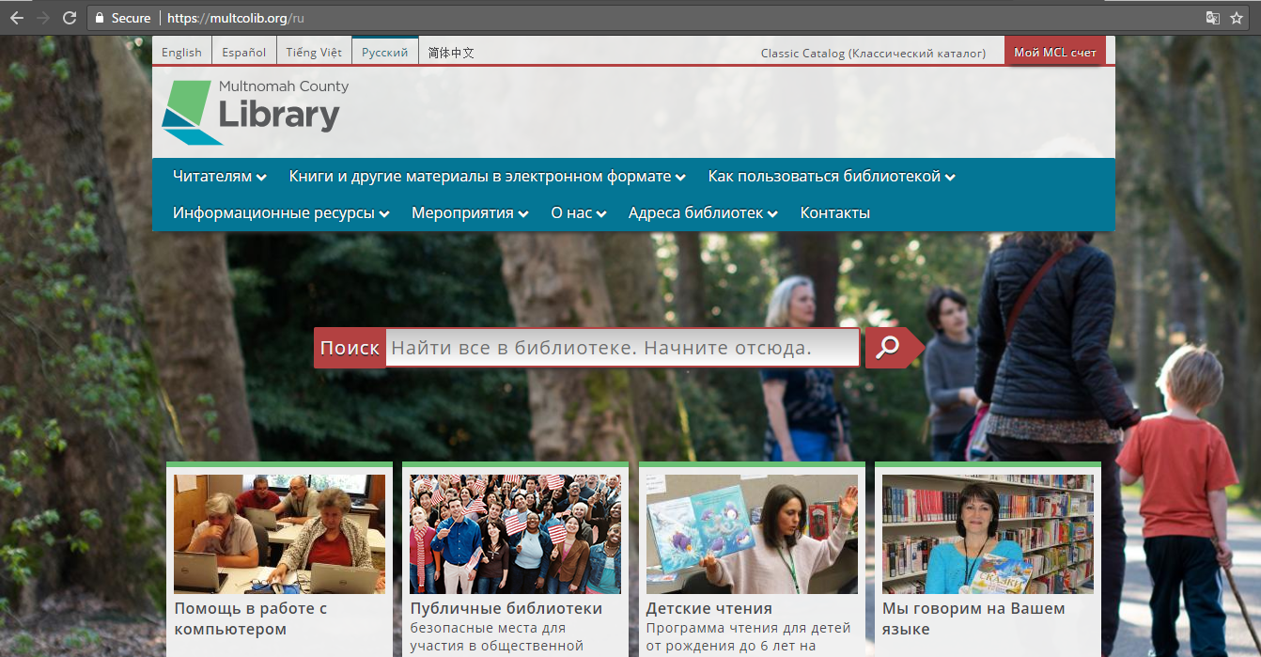

Slide 88
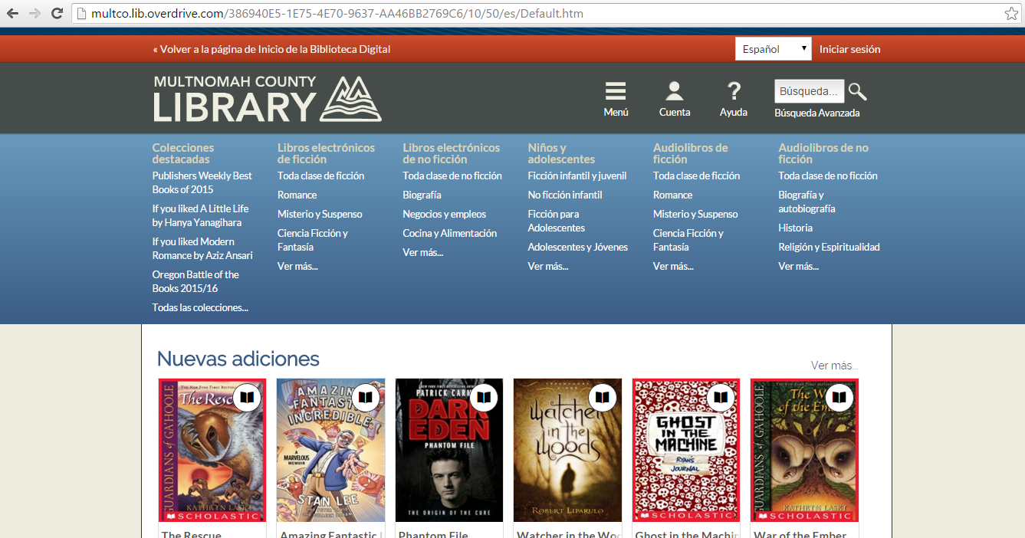

Slide 89
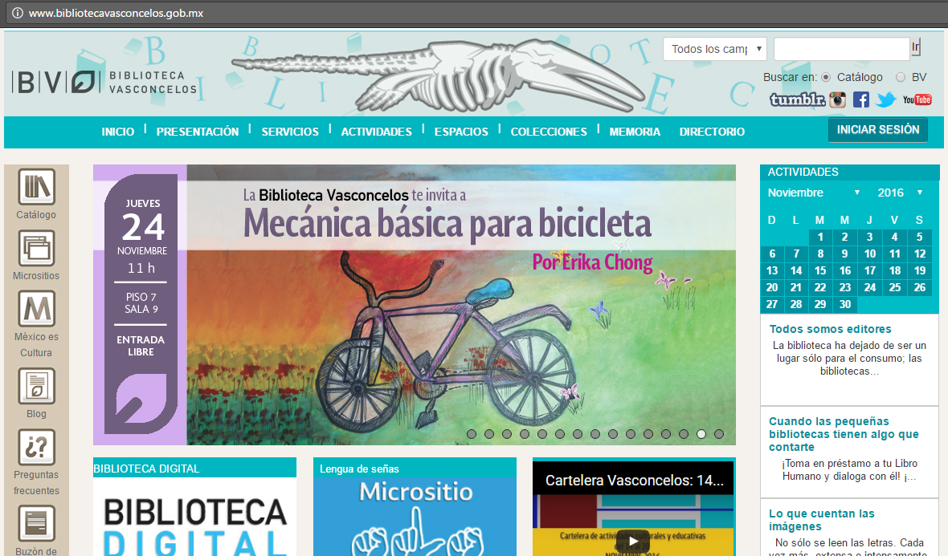

Slide 90


Slide 91


Slide 92


Slide 93
Basic Plan to Serve Spanish Speakers
-Example-
Library Profile
Programs & Services
Collections, Cultural & Social Programs
Marketing & Outreach
Local Media, Social Media, Word-of-Mouth,
Door-to- Door
Preferences, Likes
Popular hobbies
Education levels
Usage of technology devices
Level of reading and writing in X language - and in English.
Schedules
Time in the USA
Demographics
Community Fairs and Events
Local churches, community organizations, schools, stores, parks
Regional Coalitions
Citywide Events, Meetings, Conferences

Slide 94
21st Century Libraries Are For Everyone:
Serving the Needs of our Most Vulnerable Community Members
Instructor
Loida Garcia-Febo
International Library Consultant
loidagarciafebo@gmail.com

